Slide 1
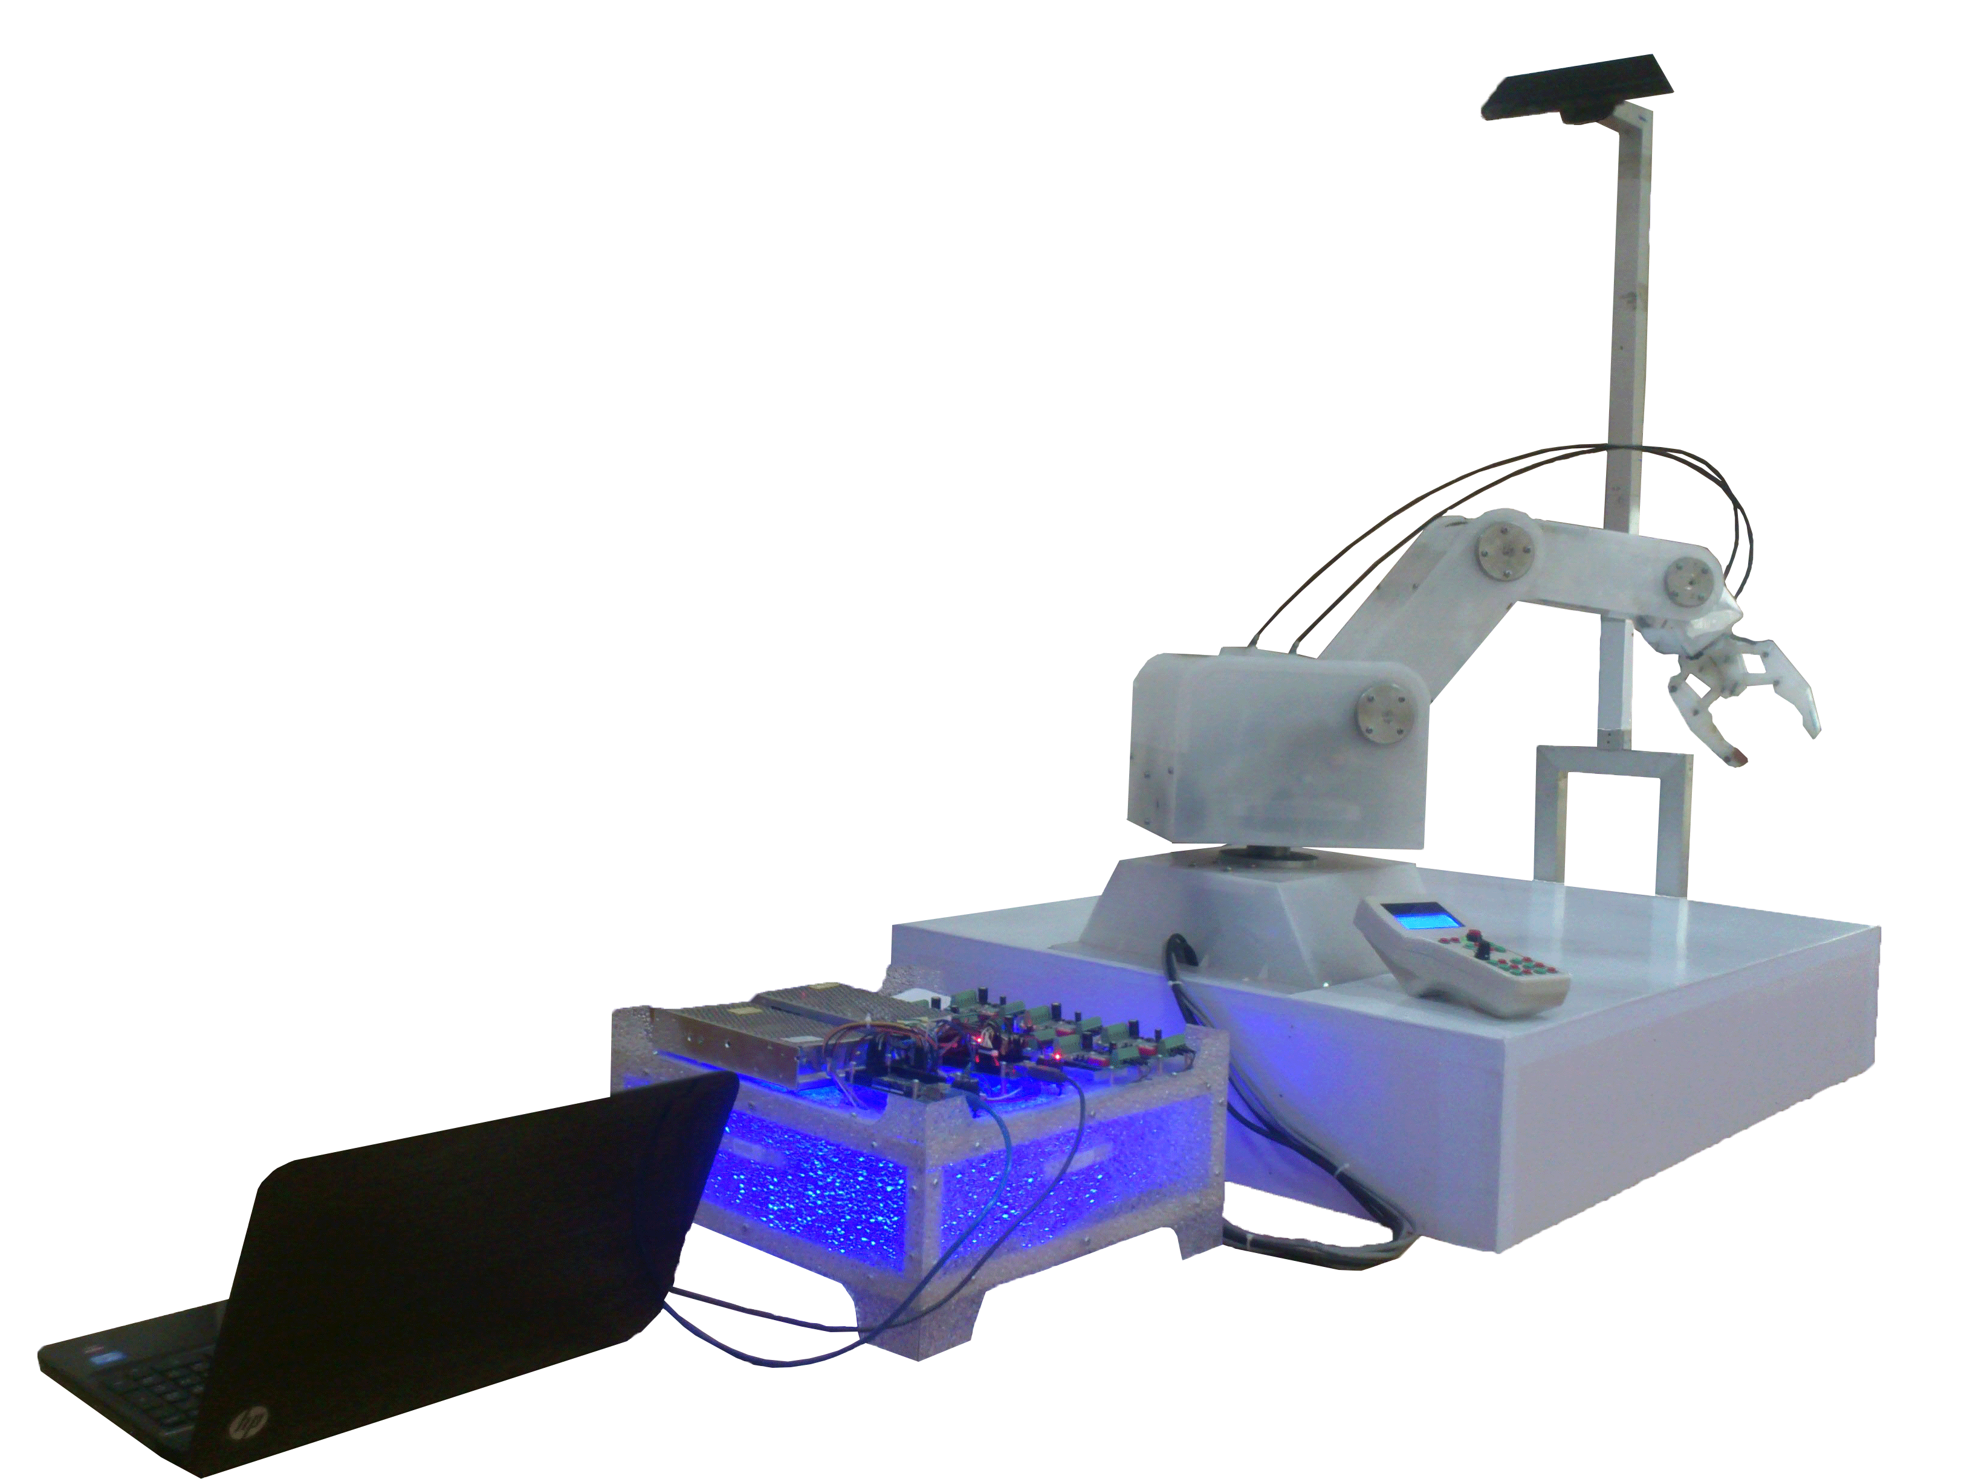
The Design and Implementation of Smart Robot Arm for Industrial Application

Slide 2
Problem Statement
The Aim of this project is to –
Design and Implement a Robot Arm that can be used in industrial Application.
Automate the assembly process
Make this Arm Smart enough to repeat the process – Mass Production

Slide 3
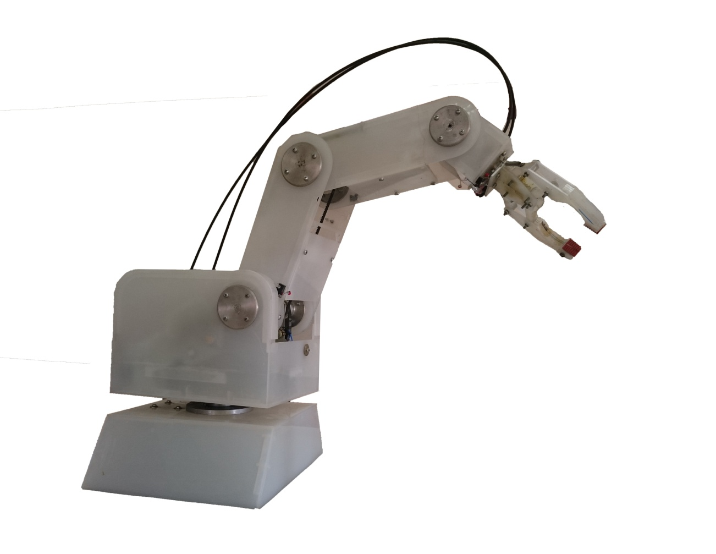
What is new?
Remotely controlled
Programmable
It can work on any production line due to it has computer vision capability.

Slide 4
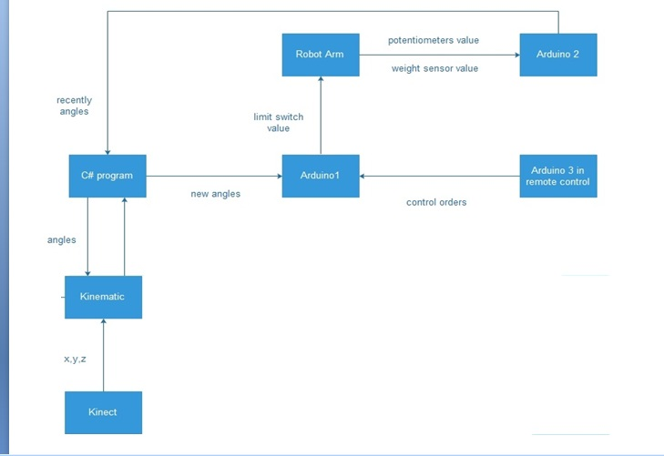

Slide 5
Operation Modes
Manual
method
Automatic method
Remote control
Computer –Based Control
Save &
Repeat
Kinect & Kinematic

Slide 6
Manual Control

Slide 7
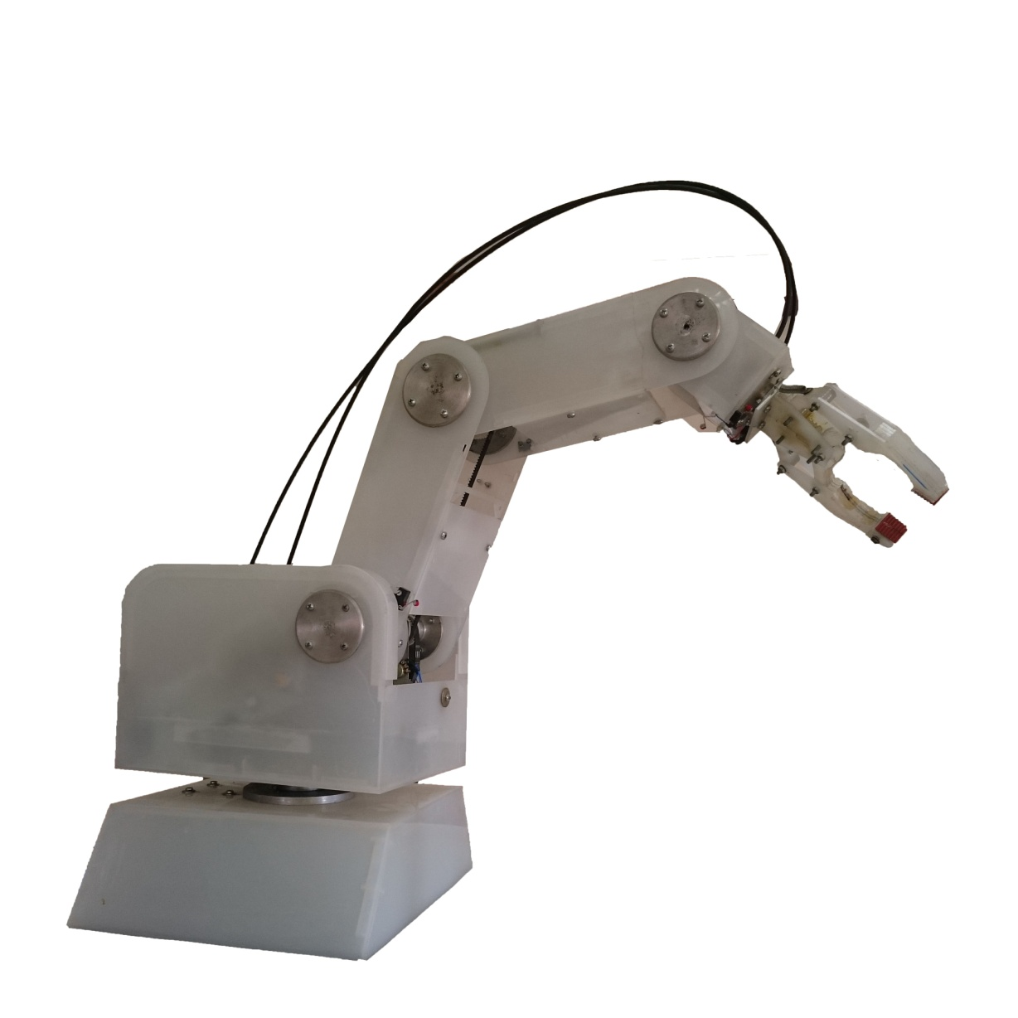
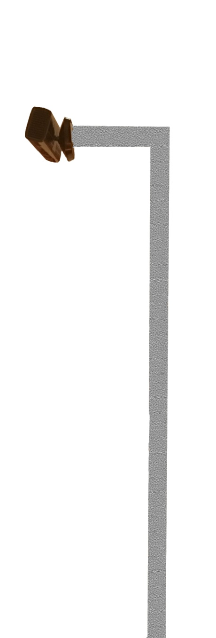
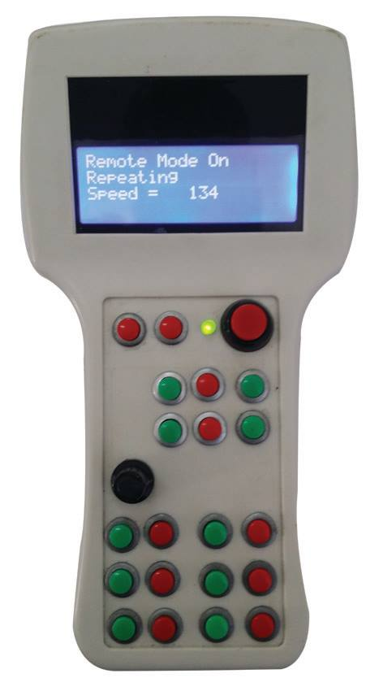
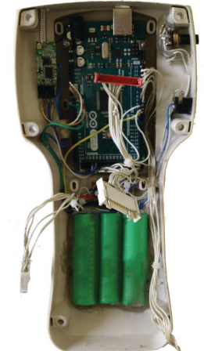
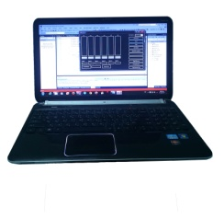
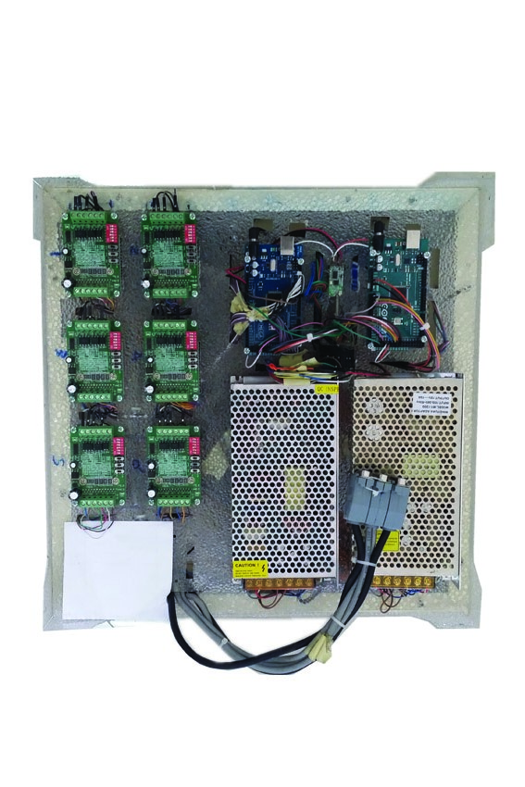

Manual Control
1
2
Remote Control
3

Slide 8

Manual Control
Rrmote Control

Slide 9
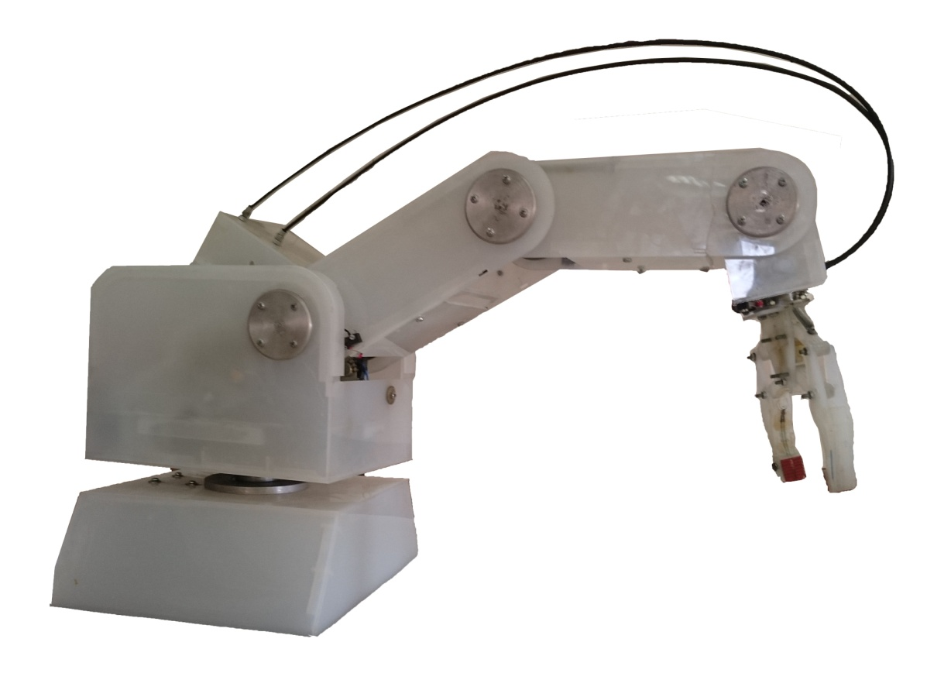
Manual Control
Rrmote Control

Slide 10
Operation Modes
Manual
method
Automatic method
Remote control
Computer –Based Control
Save &
Repeat
Kinect & Kinematic

Slide 11
Manual Control
Computer-Based Control

Slide 12
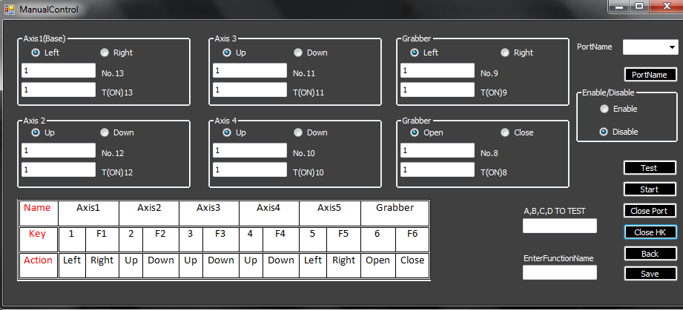
Manual Control
Lap Control

Slide 13
Manual Control
Computer-based Control

Slide 14
Operation Modes
Manual
method
Automatic method
Remote control
Computer –Based Control
Save &
Repeat
Kinect & Kinematic

Slide 15
Save & Repeat

Slide 16
Saving

Slide 17
Repeating

Slide 18
Operation Modes
Manual
method
Automatic method
Remote control
Computer –Based Control
Save &
Repeat
Kinect & Kinematic

Slide 19
Kinect

Slide 20
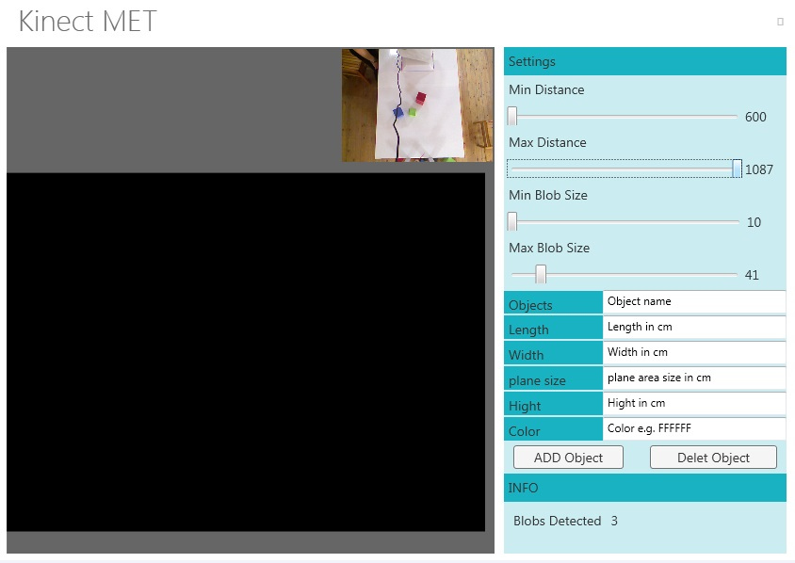

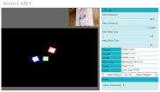
Kinect

Slide 21
Application description :-
1- Detect All Objects In Work Space
2- Extract Objects Features
3- Match each Object Features with desired features
4-find coordinates of desired object (x,y,z)

Slide 22
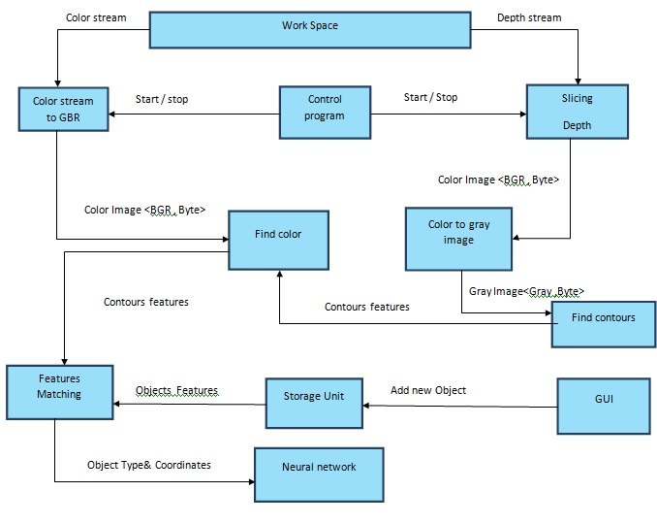
Kinect Flow Diagram
5
1
2
6
3
4
9
8
7
10

Slide 23
Kinematic

Slide 24
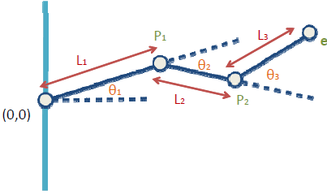
6.2 Forward Kinematic Mechanism
The process of computing world space geometric description based on joint DOF values.

Slide 25
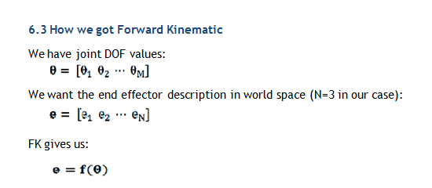

Slide 26
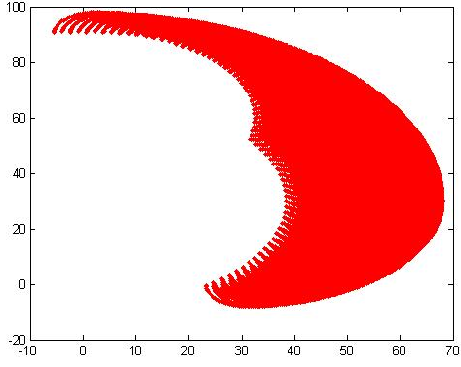
Search space
All points that arm robot can reach at our work space

Slide 27
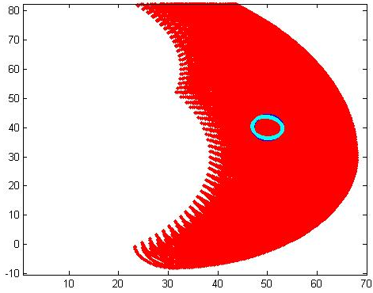
Try to draw a circle on Simulation of forward kinematic with our arm

Slide 28

Forward kinematic

Slide 29
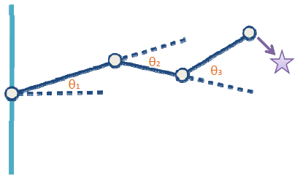
6.5 Inverse Kinematic
The goal of inverse kinematics is to compute the vector of joint DOFs that will cause the end effector to reach some desired goal state.

Slide 30
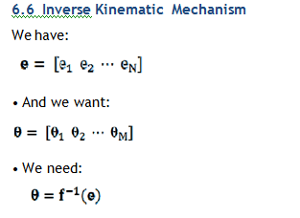

Slide 31
Inverse kinematic

Slide 32
Hardware

Slide 33
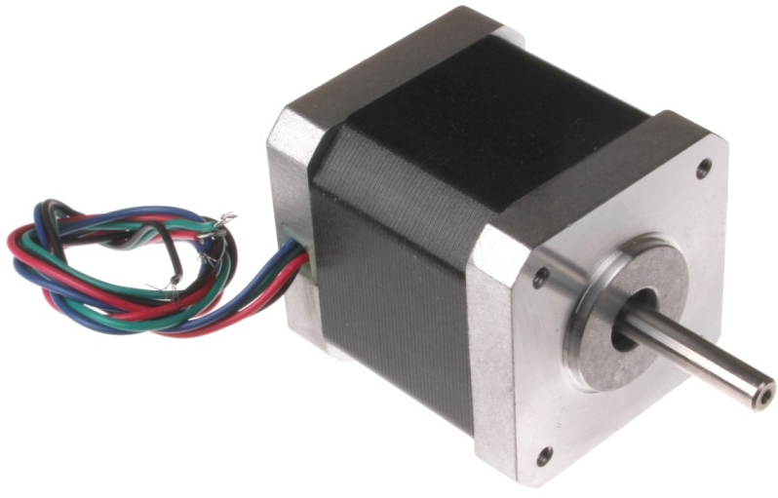
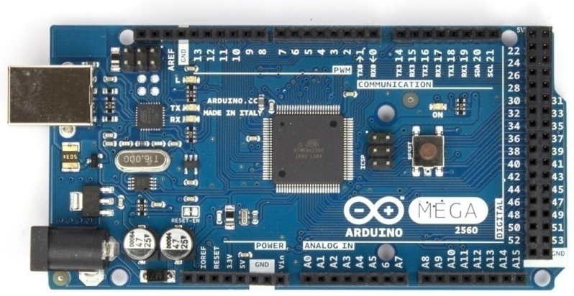
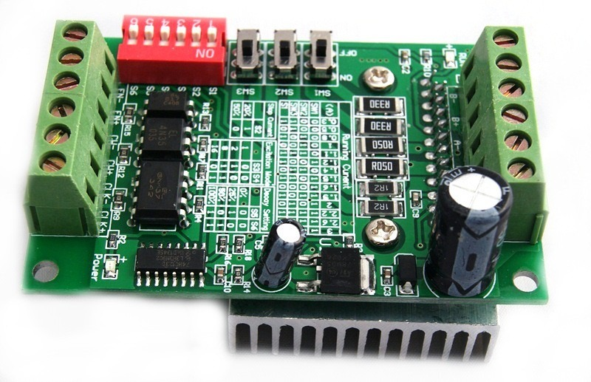
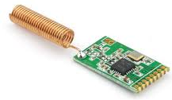
Stepper Motor
Arduino Mega
Wire less Module
Stepper Motor
Driver

Slide 34
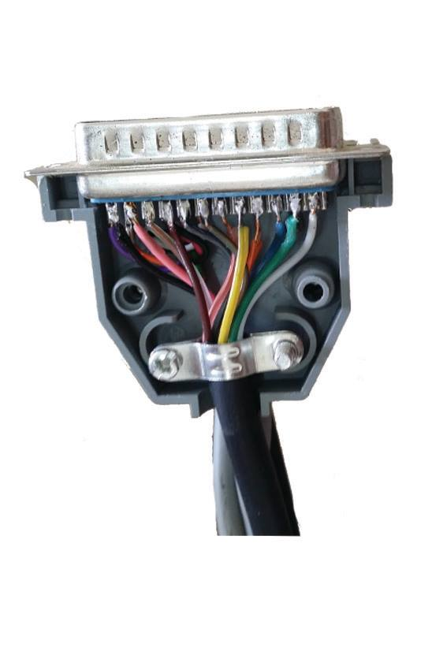
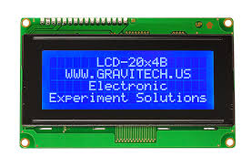
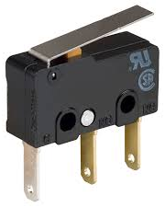
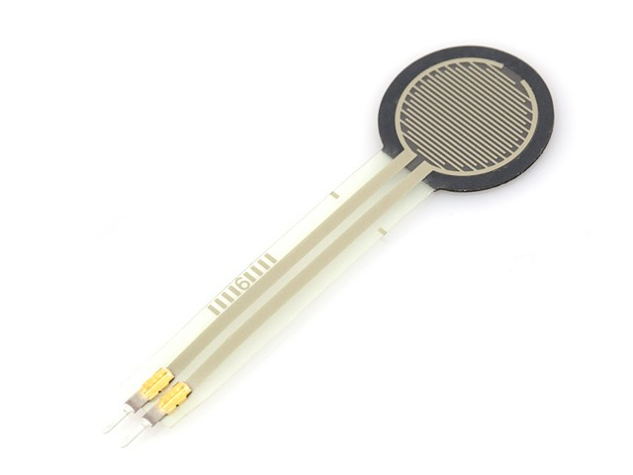
LCD 4* 20
Cable
Limit Switch
Weight Sensor

Slide 35
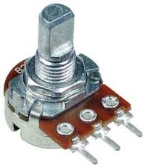
Potentiometer

